Slide 1
Chuckie Egg

Slide 2
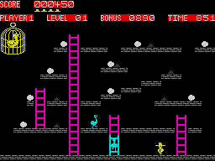
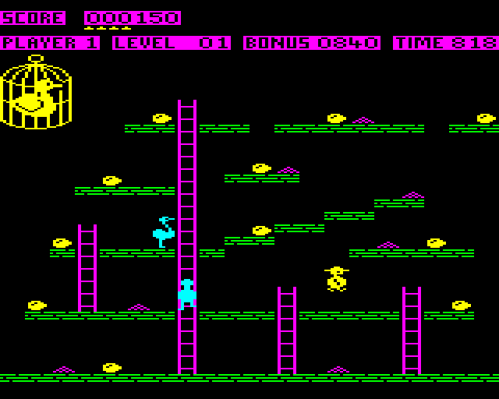
Concept
Recreation of the classic arcade game from 1983 “Chuckie Egg”
The goal is to collect all the eggs in a level while avoiding the enemies
Once all the eggs in a level are collect the player movies to the next level

Slide 3
How it was developed
Pygame was chosen as the library to develop the game
Programmed using OOP
Heavy emphasis on applying game design patterns
Some of the more used patterns include:
  Game Loop
  Singleton
  Bytecode
  State Machine

Slide 4
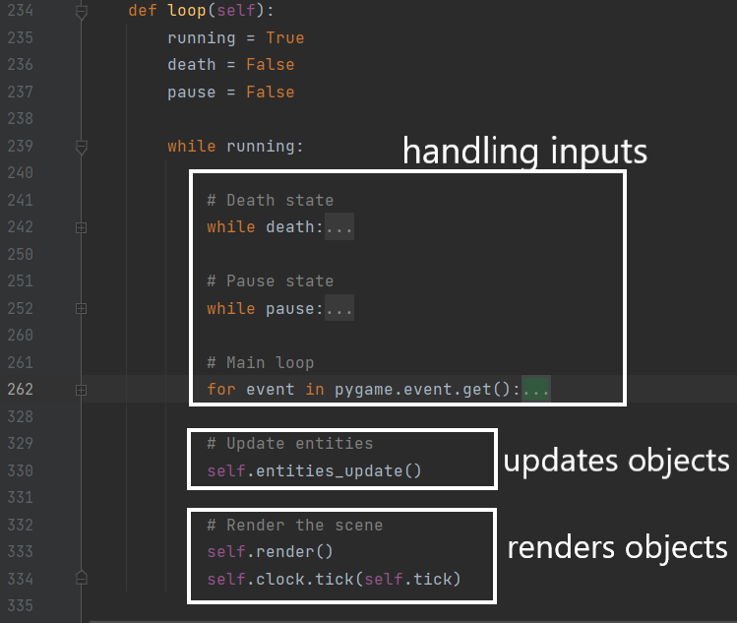
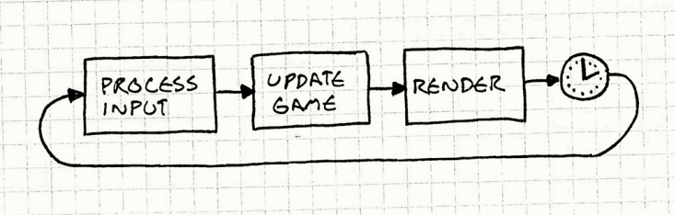
Game Loop
Each frame the game processes user inputs
Based on the input it updates the objects positions
Then renders the objects

Slide 5
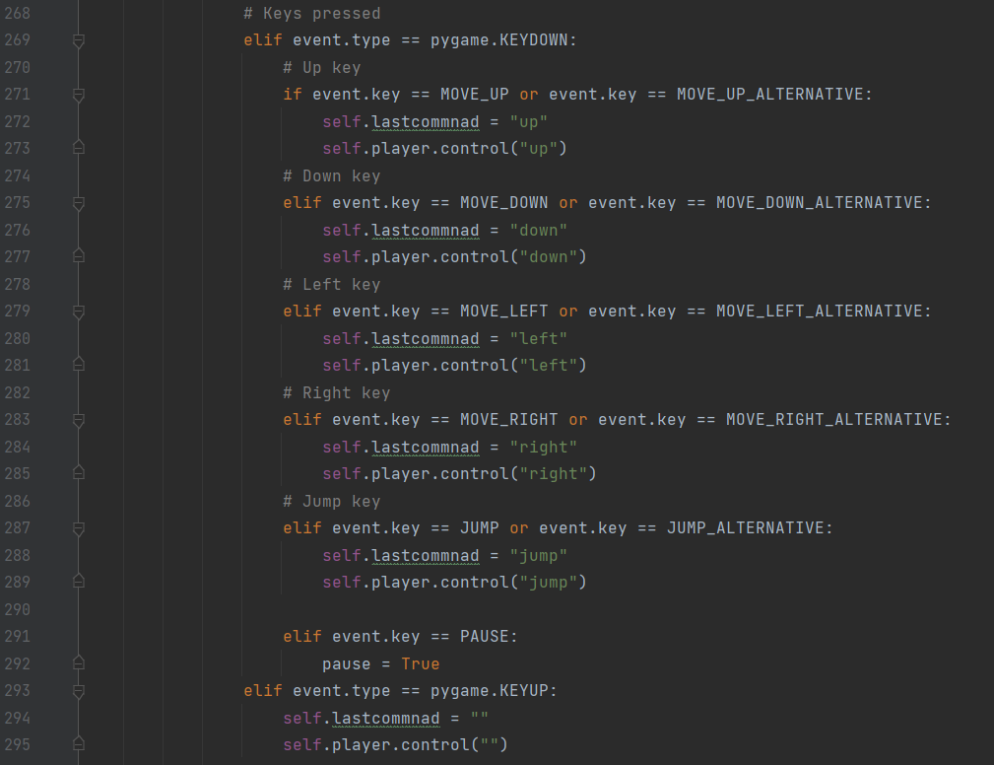
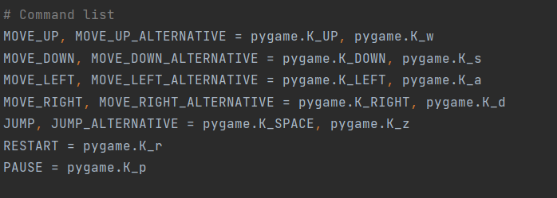
Handling Commands
Depending on the button pressed the player is issued a different command
Last command used is saved

Slide 6
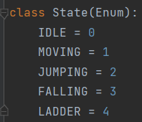
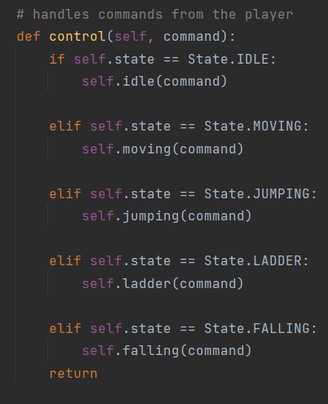
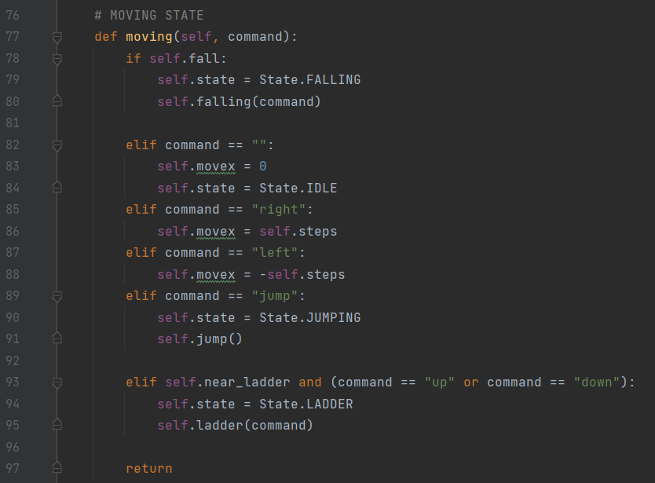
Player State
The player is coded as a state machine
Whenever an input is sent, the player checks it’s state and performs different actions depending on the current state and the command sent

Slide 7
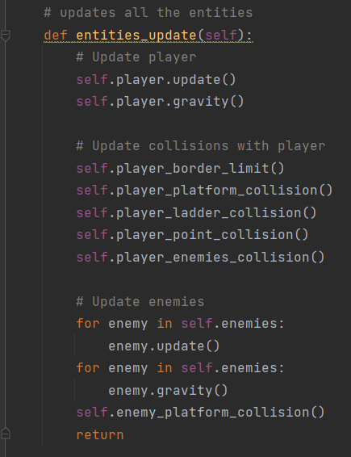
Update
Objects that move in the scene contain an update method
Main each frame updates these objects
Collisions and gravity are also updated
Player updates include the sprite being displayed (to simulate walking) and current position

Slide 8
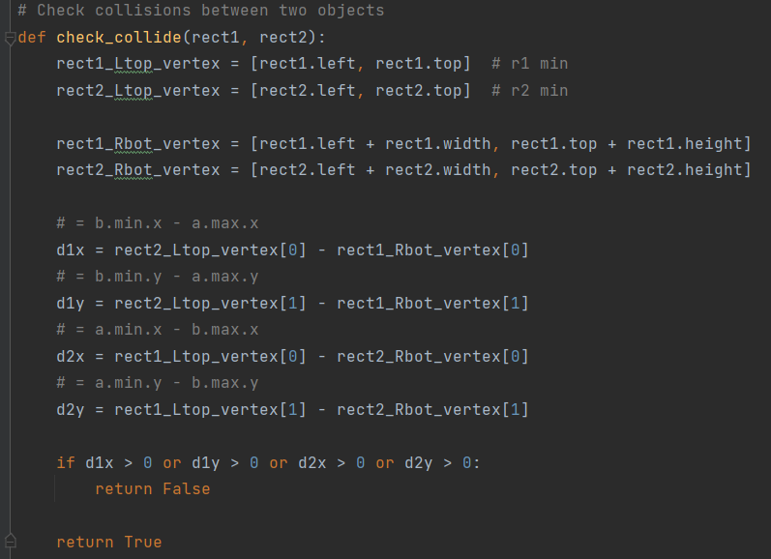
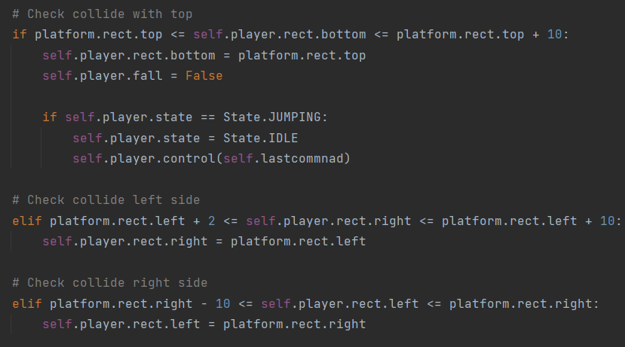
Collisions
Collisions are calculated using the AABB algorithm
For all the objects we create a rectangle (rect) from the given sprite image
Collisions are calculated based on the objects rect’s
Usually AABB is only used for the broad phase, but since all our objects are rectangles there is no need to be more precise
Some additional calculations are also needed to determine what position the player is relative to the platform

Slide 9
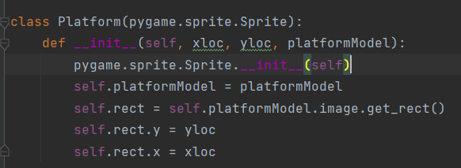
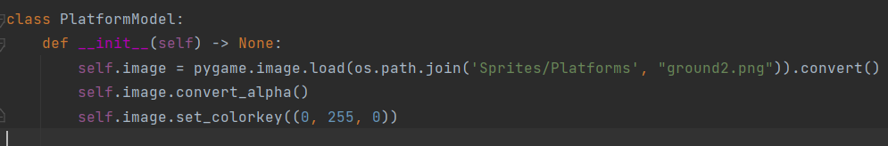
FlyWeight:
Platforms / Ladders
The player can jump to platforms and move up and down ladders
These objects are coded using the flyweight pattern

Slide 10
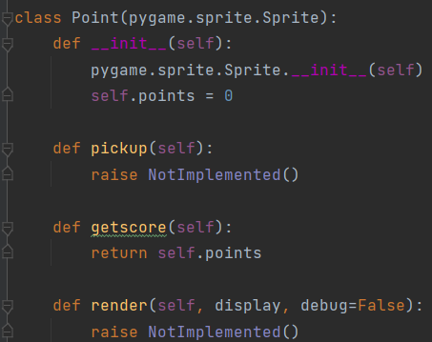
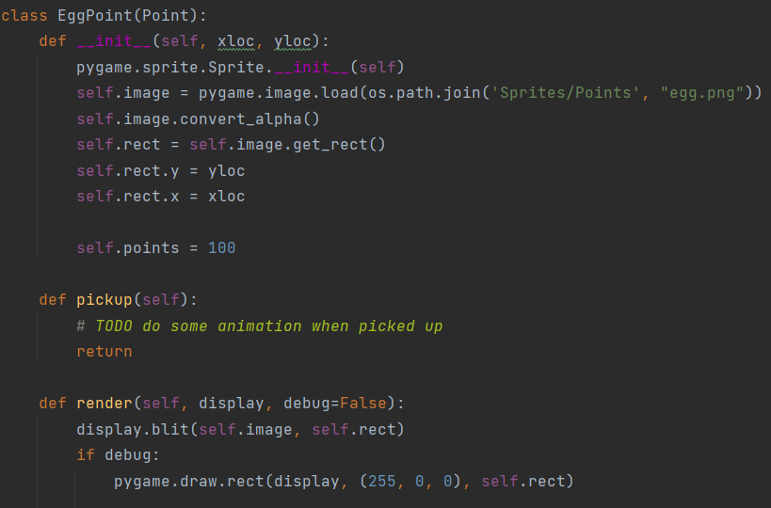
Sandbox:
Points
To complete each level the player must pickup all the “Point” objects
The base class contains the base functions (not implemented)
“Point” objects inherit from the base class and implement the methods

Slide 11
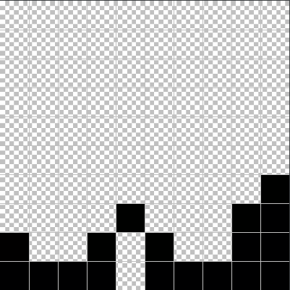
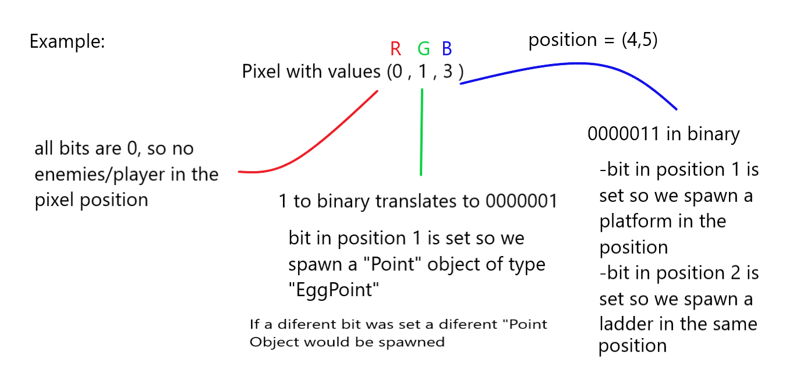
ByteCode:
Loading the levels
A singleton class is responsible for loading the levels
Levels are coded as images
The position of the objects in the level are dependant on the set bits in each pixel
Red = Player / enemies
Green = Points
Blue = Platform

Slide 12
Singletons:
Sound and Score Managers
The game features a score system and music
These features are handled by their respective managers
Managers are coded as singletons
Independent from current level
Can be accessed by any one
Only one instance

Slide 13
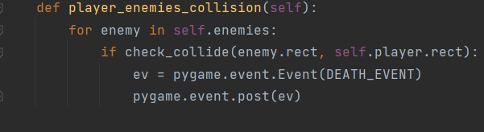
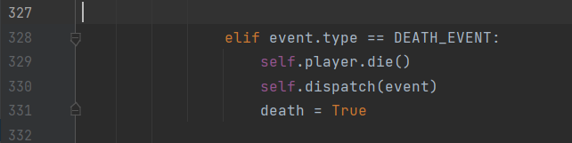
Events
Certain circumstances can cause events
Events are then handled along with other inputs
Events can be sent to other components to be handled by them

Slide 14
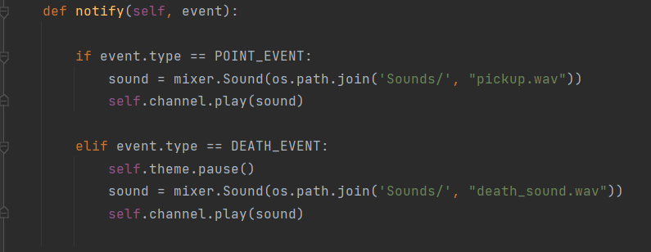
Subject and Observer
The main class has observers (Sound manager and Score Manager are coded as observers)
Some events are dispatched to observer components
These then process the events and execute various functions
For example: When the collision method detects a collision of the player with a point object an event is posted, the main then dispatches the event to the observers and the observers handle the event,

Slide 15
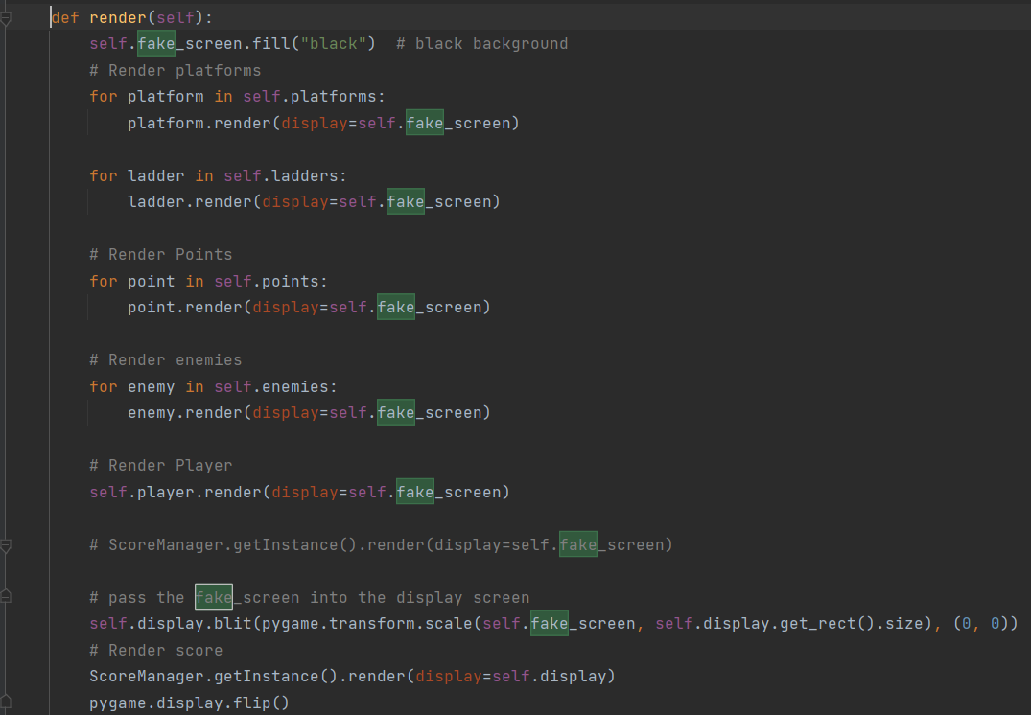
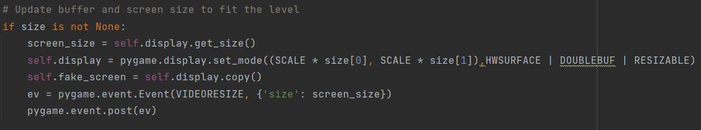
Double Buffer
Levels can have different dimensions, since we don’t want the window to change dimensions each level change
We set the display window to accumulate the whole level (set the dimensions of the window to the level dimensions but keep the previous screen size stored)
Then create a “fake” screen with the same parameters of the display window
Each object is rendered into the “fake” screen
The display window is then set to whatever size we want (to keep the sizes consistent during the levels) the “fake” window is scaled to the size of the display, then the “fake” window is displayed on the display window

